Slide 1
A sensor model for macroscopic traffic simulation
Gabriel Gomes
01/10

Slide 2
Motivation
Actuated signal control algorithms rely on approach and stopline detectors for
Vehicle counts,
Phase calls.
The challenge: Design a detector model that can
produce random calls based on the link state.
distinguish between stopline and approach positions in a single link.
(integral of flow)
(e.g. crosswalk request button)
Stopline station, through phase. Stopline station, turning phase.
Approach station, through phase.

Slide 3
Model outline
Queue estimation
Count function
Call function

Slide 4
Presentation outline
Part I: Call event generation
Headway distributions
Probability of actuation
Part II: Queue estimation
LWR and tracking shockwaves

Slide 5
Part I:
Call event generation

Slide 6
Distribution of time headways in traffic
Headway: time between passage of the front axles of consecutive vehicles.
Cowan (1975)
4 models (M1…M4) with increasing degree of generality.
Main assumptions:
A portion ѳ of vehicles are in platoons. Their headways follow the “tracking” distribution
The remainder are free vehicles. Their headways are the sum of two independent random variables: the tracking headway and the free headway:
M4:

Slide 7
Distribution of time headways in traffic
Cowan (1975)
p.d.f
c.d.f
M3:
Assume
(deterministic tracking headway)
M2:
Assume
(no platoons)
M1:
Assume
(tracking headway = 0)
Poisson process

Slide 8
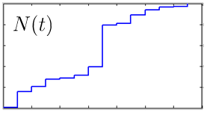
Probability of actuation Definitions
The vehicle arrival process: For a given traffic state, the passage of front axles over some point on the road is a stationary counting process,
An actuation or call occurs whenever any part of a vehicle crosses any part of a detector.
cumulative front axle count
probability of registering a call in ∆t.

Slide 9
Probability of actuation 2 cases
Zero vehicle and detector lengths
Non-zero vehicle and detector lengths
observation point
…
observation region
…

Slide 10
Probability of actuation The simplest case
M1 with point vehicles and detectors.
Exponential headways
Zero vehicle and detector lengths
→ Poisson arrival process.

Slide 11
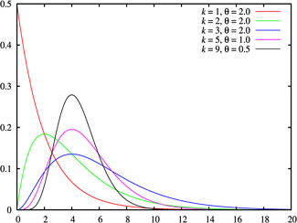
Probability of actuation Another solvable case
Erlang distribution with point vehicles and detectors.
Erlang headways
Zero vehicle and detector lengths
→ Erlang-k arrival process.
→

Slide 12
Loose ends
What about M2 and M3? What about non-zero vehicle and detector lengths?
But we don’t need , only
We will solve for M3 (→M2 and M1).

Slide 13
Probability of zero actuations for M3
With a random detector position, what is the probability of zero actuations in ∆t?
Three cases for the random detector position:
on a vehicle,
within the tracking headway,
within the free headway.
Define:

Slide 14
Probability of zero actuations for M3
Case A
Case B
Case C

Slide 15
Probability of zero actuations for M3
Case C
by memoryless-ness of the exponential distribution
Put it all together:
with

Slide 16
Probability of a call
Non-zero detector length is identical to increasing ∆t by Ld/v.
Final formula:
with

Slide 17
Probability of a call
Condition on the parameters:
Check:

Slide 18
Probability of a call Sanity checks
Sanity check: It reduces to Poisson.
Sanity check: High probability when congested.
Notice that Poisson fails in this case:
!

Slide 19
Probability of a call Sanity checks
Sanity check: P(Call) is monotonic in all directions.
Probability of a call …
… increases with vehicle length
… increases with detector length
… increases with flow
… increases with density
… increases with observation time
… decreases with platoon size
… increases with headway

Slide 20
Part II:
Queue estimation

Slide 21
Overview
Control device
queue
spillover

Slide 22
Setup and Notation
uncongested congested

Slide 23
Setup and Notation

Slide 24
Setup and Notation

Slide 25
Allowable commands

Slide 26
Allowable commands

Slide 27
General comments about the setup

Slide 28
Model: Downstream boundary flow

Slide 29
Model: Downstream boundary flow

Slide 30
Model: Downstream boundary flow
Restrict case:
Negative shock speed
Positive shock speed

Slide 31
Model: Downstream boundary flow with spillback

Slide 32
Model: Downstream boundary flow with spillback

Slide 33
Model: Downstream boundary flow with spillback

Slide 34
Model: Downstream boundary flow

Slide 35
Structure of the queue

Slide 36
Region dynamics
…

Slide 37
Region dynamics
…

Slide 38
Region dynamics
…

Slide 39
Region dynamics
…

Slide 40
Delay computation
…

Slide 41
The green/red case
…

Slide 42
The green/red case
…

Slide 43
The green/red case
…

Slide 44
The green/red case
…

Slide 45
Applications

Slide 46
Application #1 : Real-time estimation of delays

Slide 47
Application #2 : Macroscopic simulation

Slide 48
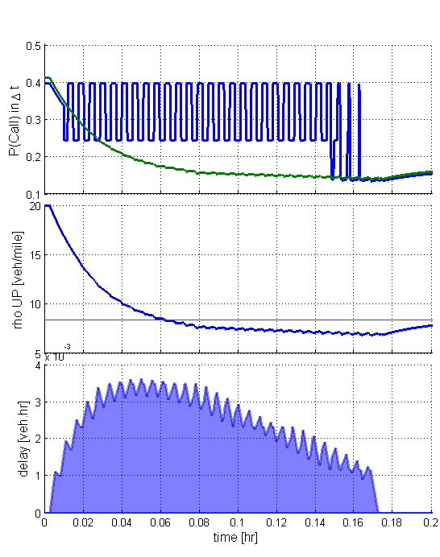
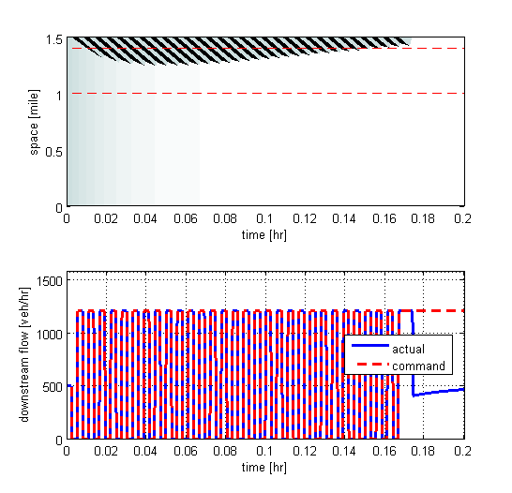
The green/red case: An example
Cycle = 20 sec
Green split = 50%
1500
25
100
Total delay = 1.45 veh.hr

Slide 49
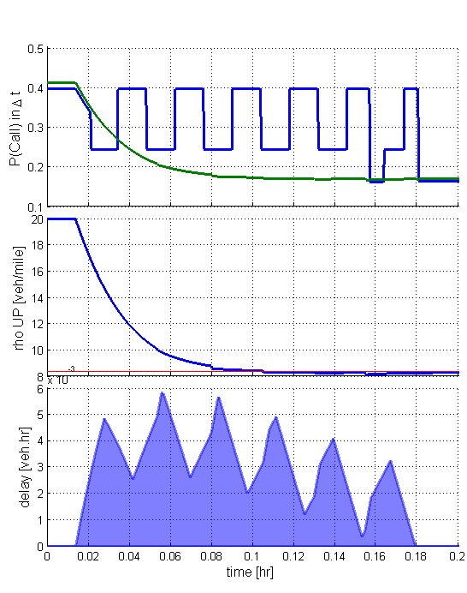
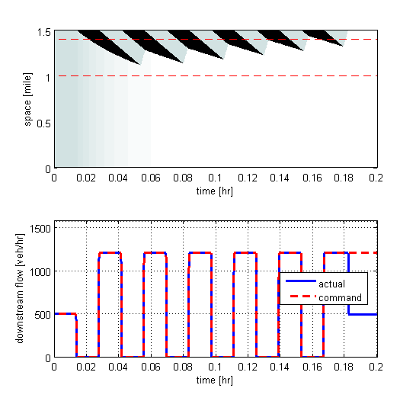
The green/red case: An example
Cycle = 100 sec
Green split = 50%
1500
25
100
Total delay = 1.85 veh.hr

Slide 50
Example: The general case with triangular F
1500
20
25
100

Slide 52
FIGURES FOR PAPER
Control device
queue
spillover

Slide 53
Negative shock speed
Positive shock speed

Slide 54
…

